Slide 1
Employee Data Analysis using Excel
STUDENT NAME: Deepak kumar. T
REGISTER NO: 422200292
NM ID: E7F069BCA0BC21BBF334FB4EDBF46ECD
DEPARTMENT: B.Com ISM (Information System Management)
COLLEGE: Agurchand Manmull Jain College

Slide 2
PROJECT TITLE
Employee Performance Analysis using Excel

Slide 3

AGENDA
Problem Statement
Project Overview
End Users
Our Solution and Proposition
Dataset Description
Modelling Approach
Results and Discussion
Conclusion
3/21/2024 Annual Review

Slide 4

PROBLEM STATEMENT
1.Employee performance is defined as how well a person executes their job duties and responsibilities. The companies assess their employees performance on an annual or quarterly basis to define certain areas.
2.The Dataset overview of an employee, contains the information about employees in a company.

Slide 5

PROJECT OVERVIEW
The project involves analyzing employee data using Excel which helps in gaining the knowledge regarding organizational data, performance statistical analysis by creating visualizations to understand the employee performances.

Slide 6

WHO ARE THE END USERS?
The end users in employee performance analysis include:
1. Human Resource management professionals.
2. Data Analysts.
3. Team Leaders.

Slide 7

OUR SOLUTION AND ITS VALUE PROPOSITION
1.Filtering- purpose to fill the missing values.
2.Conditional formatting- blank values.
3.Using- Pivot table and chart.

Slide 8
Dataset Description
Employee data set-Kaggle
There are 26 features. The important ten features are;
1.Employment ID
2.First name
3.Last name
4.Gender
5.Employee status
6.Employee type
7.Employee classification
8.Performance score
9.Current employee ratings
10.Business units

Slide 9

THE "WOW" IN OUR SOLUTION
Performance Level– These include the categories such as Levels in very high, high, medium, low, etc...
3/21/2024 Annual Review
9

Slide 10
MODELLING
The modelling in this employee performance analysis project includes the following:
1.Data collection
2.Data cleaning
3.Results
4.Pivot table
5.Chart
10

Slide 11
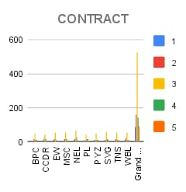
RESULT
11

Slide 12
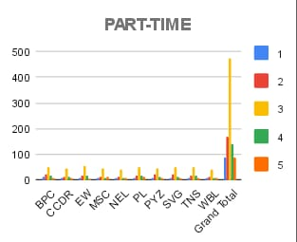

Slide 13
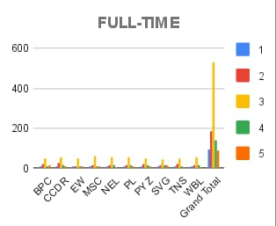

Slide 14
conclusion
1.The conclusion is the employee data analysis reveals the key insights in workforce performance and areas needed for improvement.
2.The effective data analysis provides a foundation for the improvised planning and operational developments, which leads to a motivated and productive workforce environment.

